Slide 1

Welcome!
Secure Agile

Slide 2
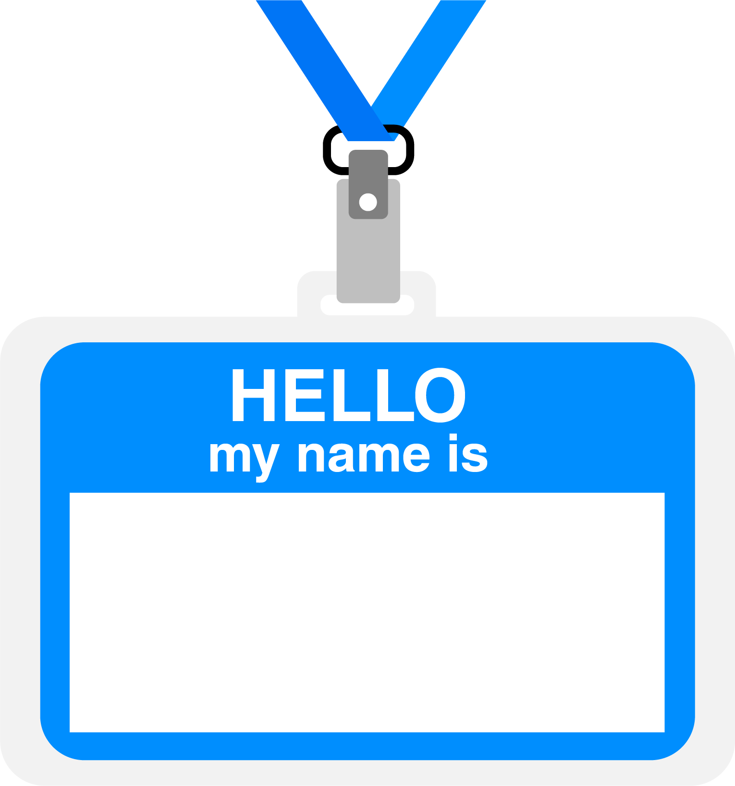

Hello
About me...
30 years in the industry
25 years in teaching
Certified Cloud architect
Passionate about learning
Also, passionate about Reese’s Cups!
Allen Sanders
Senior Technology Instructor
Pluralsight ILT
Notes:
After introducing self, have students introduce themselves:
Name?
How long with the company?
What are you hoping to come away from this training having gained in terms of knowledge and/or information that you can take back with you to your teams and your day-to-day role?

Slide 3
Agenda
Learning objectives
Agile vs. Waterfall
Planning with security in mind
Security-focused testing

Slide 4
How We’re Going to Work Together
Slides and words to highlight key concepts
Demos to bring those concepts “to life”
Discussion groups and lab work (which will take place in sandboxes provided via AWS WorkSpaces) for hands-on reinforcement
NOTE: I welcome being interrupted – if you need more info, or clarification, or anything else, just break in and ask. I am here to help you.

Slide 5
Learning Objectives

Slide 6

Learning Objectives
Understand key concepts and considerations when leveraging DevSecOps in an Agile environment to help “shift security left” during software development
Construct and prioritize a threat model for an application being developed and use that threat model as a planning tool to guide each phase of the SDLC in a security-minded manner
Speak to the value of DevSecOps and its consistent application as a set of standards and best practices

Slide 7
Learning Objectives
Monitor, patch and scan for vulnerabilities in the Operating System (Windows and Linx) and underlying Infrastructure configuration
Effectively utilize GitLab for Source Code Management and CI/CD, including:
Understanding and navigating practical activities related to source code repositories in GitLab
Effectively use Software Composition Analysis (SCA), Static Application Security Testing (SAST), and Dynamic Application Security Testing (DAST)
Notes:
GitLab: repository creation and branching, integration of automated testing into the pipeline, creating and processing merge requests to support Continuous Integration of changes across the development team, and integration with an artifact repository for storing build outputs

Slide 8
Agile vs. Waterfall

Slide 9
Waterfall Software Development
A sequential development process that flows like a waterfall through all phases of a project (requirements, design, implementation, testing, and deployment for example), with each phase completely wrapping up before the next phase begins.
Key aspects:
Majority of research done up front
More accurate time estimates
More predictable release date
Cons:
Process is brittle – can’t pivot easily in terms of changing requirements
Long lead times – difficult to respond to rapid business evolution
Tools:
Commonly use Gantt charts (or something similar) to track projects, subtasks and dependencies
Notes:
Talk about waterfall experience/failure

Slide 10
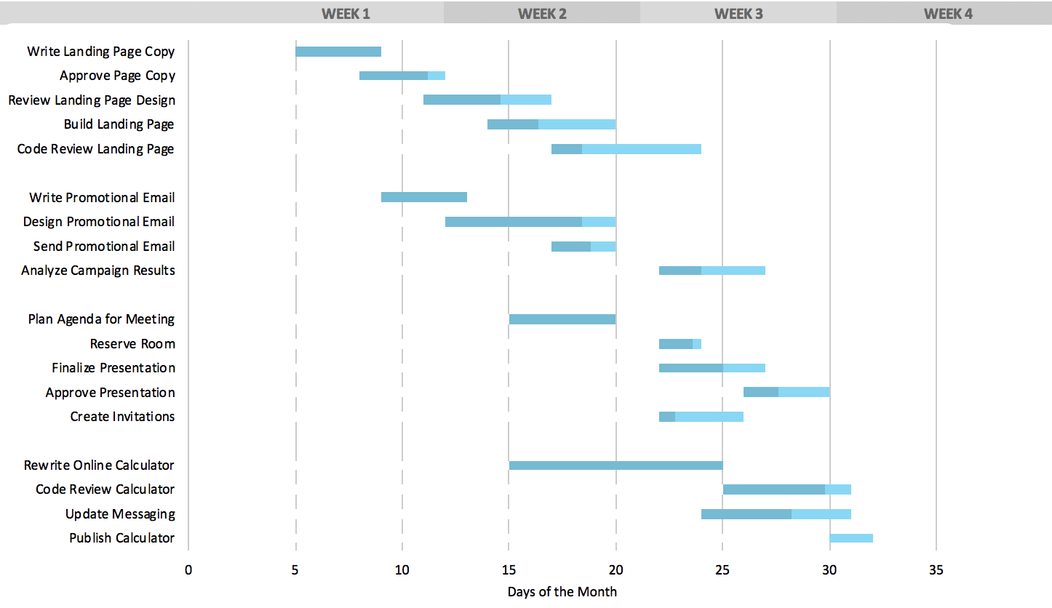
Typical Gantt Chart

Slide 11
Agile Software Development
A group of software development methodologies based on iterative development.
Requirements and solutions evolve through collaboration between self-organizing cross-functional teams that include direct engagement with business stakeholders.
Key aspects:
Incremental delivery
Always ready to ship
Continuous inspection of work product and process provides feedback for continuous improvement
Better business and tech alignment

Slide 12
The Agile Manifesto and its Origins
What is it? A statement of values regarding approaches to how teams create and ship software
When was it made? 2001, by 17 top software developers and consultants
Key aspects:
12 values were agreed upon
These values are NOT a process, implementation or standard; they are opinions
Many popular project management methodologies have arisen that are based on these values
Many Agile implementations are poorly executed; it takes great cooperation between business leadership and a competent, self-guided dev team to make it work

Slide 13

Agile Values
Individuals & Interactions
Processes & Tools
Working Software
Comprehensive Documentation
Customer Collaboration
Contract Negotiation
Responding to Change
Following a Plan

Slide 14
Key Elements of the Agile Approach
The Agile method is an iterative and incremental tactic to software design that utilizes constant planning, understanding, upgrading, team partnership, development, and delivery.
It is driven by the principles of providing value and collaborating with stakeholders.
It starts with customers defining the end uses of the final product and the kind of problems the final product attempts to address.
Designated teams start to plan and work on a complete process through planning, implementing, and appraising.
Since the development process is iterative, errors are resolved in the intermediate stage of the project.

Slide 15
Modern Approaches to Agile Software Development
Several project management approaches implement Agile values in some way. Often, they bring in elements of other approaches.
Popular methodologies:
Kanban
Uses visual boards to view & organize tasks
Uses elements of “just in time” lean manufacturing strategies
Scrum
Aligns closely with Agile values
Breaks down product development into iterative sprints
Scaled Agile Framework (SAFe)
Workflow and organizational patterns to help deploy Agile at scale
Can support large organizations
Emphasizes throughput
Makes use of exclusive roles (“Scrum Lead”, “Product Owner”)
Emphasizes constant communication

Slide 16
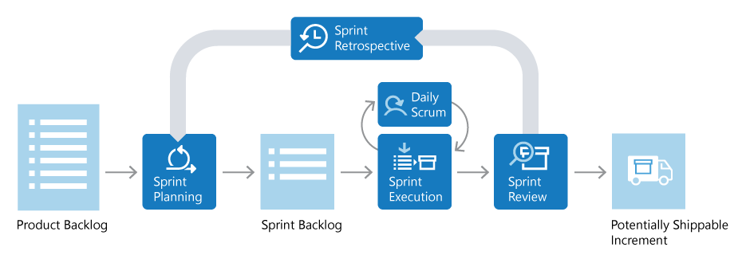
Diagram of Typical Scrum Sprint
Source: https://docs.microsoft.com/en-us/devops/plan/what-is-scrum

Slide 17
Scrum Roles
Product Owner
Scrum Lead
Scrum Team

Slide 18
Scrum Roles
Product Owner
Responsible for what team builds and why
Keeps backlog up to date and in correct priority order
Scrum Lead
Scrum Team

Slide 19
Scrum Roles
Product Owner
Ensures that Scrum process is followed by team
Responsible for the fidelity of the process
Part coach, part team member, part cheerleader
Scrum Lead
Scrum Team

Slide 20
Scrum Roles
Product Owner
Scrum Lead
Scrum Team
People building the product
Responsible for product build (and associated quality)

Slide 21
Planning with Security in Mind

Slide 22

The Flat Backlog
Observation 1: Do You Know What You‘re Building?
Arranging user stories in the order you build them doesn‘t help when you want to answer the question
"What does the system you‘re building do?" to others.
SPRINT 1 Do stuff...
SPRINT 1 Do more stuff...
SPRINT 2 Do even more stuff...
SPRINT 2
priority
Observation 2: Know How Things Relate?
You can‘t see how everything fits together.
Making decisions on what to build next is difficult.
Sure you haven‘t forgotten about important features?
Observation 3: Know You Build The Right Things?
You can‘t see how your users experience the product.
Planning coherent, value-driven releases is difficult.
Notes:
Story mapping is a highly collaborative method/technique/process/pattern that uses visual thinking with an aim to establish common & shared understanding in cross-functional product teams with the help of narratives.

Slide 23
The Backlog
The User Story Map
priority
SPRINT 1 Do stuff...
SPRINT 1 Do more stuff...
SPRINT 2 Do even more stuff...
SPRINT 2
Time
necessity

Slide 24
User Story Map – Prerequisites
Time
wall, whiteboard or flip chart paper
Customer/Stakeholders
Product Owner
SMEs
Architects
Agile Team
Scrum Master
Big Wall, whiteboard, flip chart papers
Sticky Notes
Sharpies
Time & Patience
necessity
sticky notes
Security Resources
Threat Model
Notes:
Story mapping is a highly collaborative method/technique/process/pattern that uses visual thinking with an aim to establish common & shared understanding in cross-functional product teams with the help of narratives.

Slide 25
Anatomy Of A Map
RBAC & ABAC
Users / Personas
Who are your users and what are their goals?
Notes:
Story mapping is a highly collaborative method/technique/process/pattern that uses visual thinking with an aim to establish common & shared understanding in cross-functional product teams with the help of narratives.

Slide 26
Anatomy Of A Map
Go this way First, i.e., breadth
User Tasks ("Walking Skeleton“) Things a user does to achieve a goal. Starts with a verb, e.g., "Send Email“.

Slide 27
Anatomy Of A Map
User Activities ("Backbone“)
Groupings of similar tasks.

Slide 28
Anatomy Of A Map
User Stories
Flesh out the user journey in detail:
Sub-tasks, alternatives, exceptions, etc.
Then this way, i.e., depth

Slide 29
Release(s) from Story Map
Release Slice Identifies the smallest number of user stories for each task.
Achieves your user‘s goals.
Measurable Outcomes –
Goal, Metrics, KPI, Secure Implementation

Slide 30


Sprint Planning with Security in Mind
Threat modeling
RBAC & ABAC requirements
Secure design principles (OWASP Top 10)
Data classification & risk assessment
Agile design reviews with security focus included
Epic, feature, story creation with security focus included
Acceptance criteria with security focus included
Release
Plan
Operate
Test
Develop
Feedback
Quality gates guard against moving security defects forward

Slide 31
Sprint Planning with Security in Mind
Release
Plan
Operate
Test
Develop
Feedback
Secure coding best practices (OWASP Top 10)
Static code analysis (SCA & SAST)
Security-focused unit tests
Quality gates guard against moving security defects forward

Slide 32
Sprint Planning with Security in Mind
Continuous testing for both functionality and security
DAST
Integrating security tests into manual and automated test suites
Release
Plan
Operate
Test
Develop
Feedback
Quality gates guard against moving security defects forward

Slide 33
Sprint Planning with Security in Mind
Secure deployments
Secure configuration
Secure rollback strategies
Continuous monitoring for threats
Security incident response
Release
Plan
Operate
Test
Develop
Feedback
Quality gates guard against moving security defects forward

Slide 34
Sprint Planning with Security in Mind
Release
Plan
Operate
Test
Develop
Feedback
Security problem management
Hardening of processes, systems, infrastructure
Updates/enhancements to threat model
Quality gates guard against moving security defects forward

Slide 35
User Story Map – An Example
Find Product
View Product
These should also be around the map:
Product Goals
UI Sketches/Wireframes
Ideas & Principles
Personas
Search
View Product Listing
View Product Page
Search By Name
View Names
View Description

Slide 36
LAB:
Using the threat model, a list of users/personas, and the high-level diagram you created for your scenario, identify a feature you would like to build in a single sprint. For that sprint, create a set of high-level user stories with acceptance criteria and story points. For each story, discuss the following:
Have you accounted for security in the definition and acceptance criteria?
How best to describe each to keep the story detail accessible & understandable to multiple roles (engineers, business, QA)?
Are the assigned points sufficient to account for security concerns?
Sprint Planning with Security in Mind

Slide 37
Security Focused Testing

Slide 38
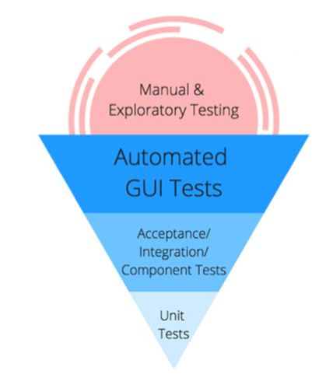
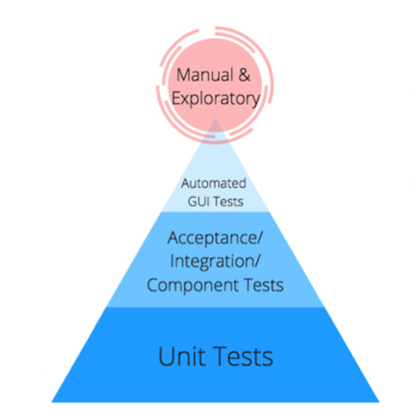
Testing Pyramids
More Time & Effort
Higher ROI

Slide 39
Agile Testing Pyramid
Manual Tests
Time
Brittle
Slower
UI
Tests
System Tests
Integration Tests
Component Tests
Unit Tests
Faster
Cost / Effort
Solid

Slide 40
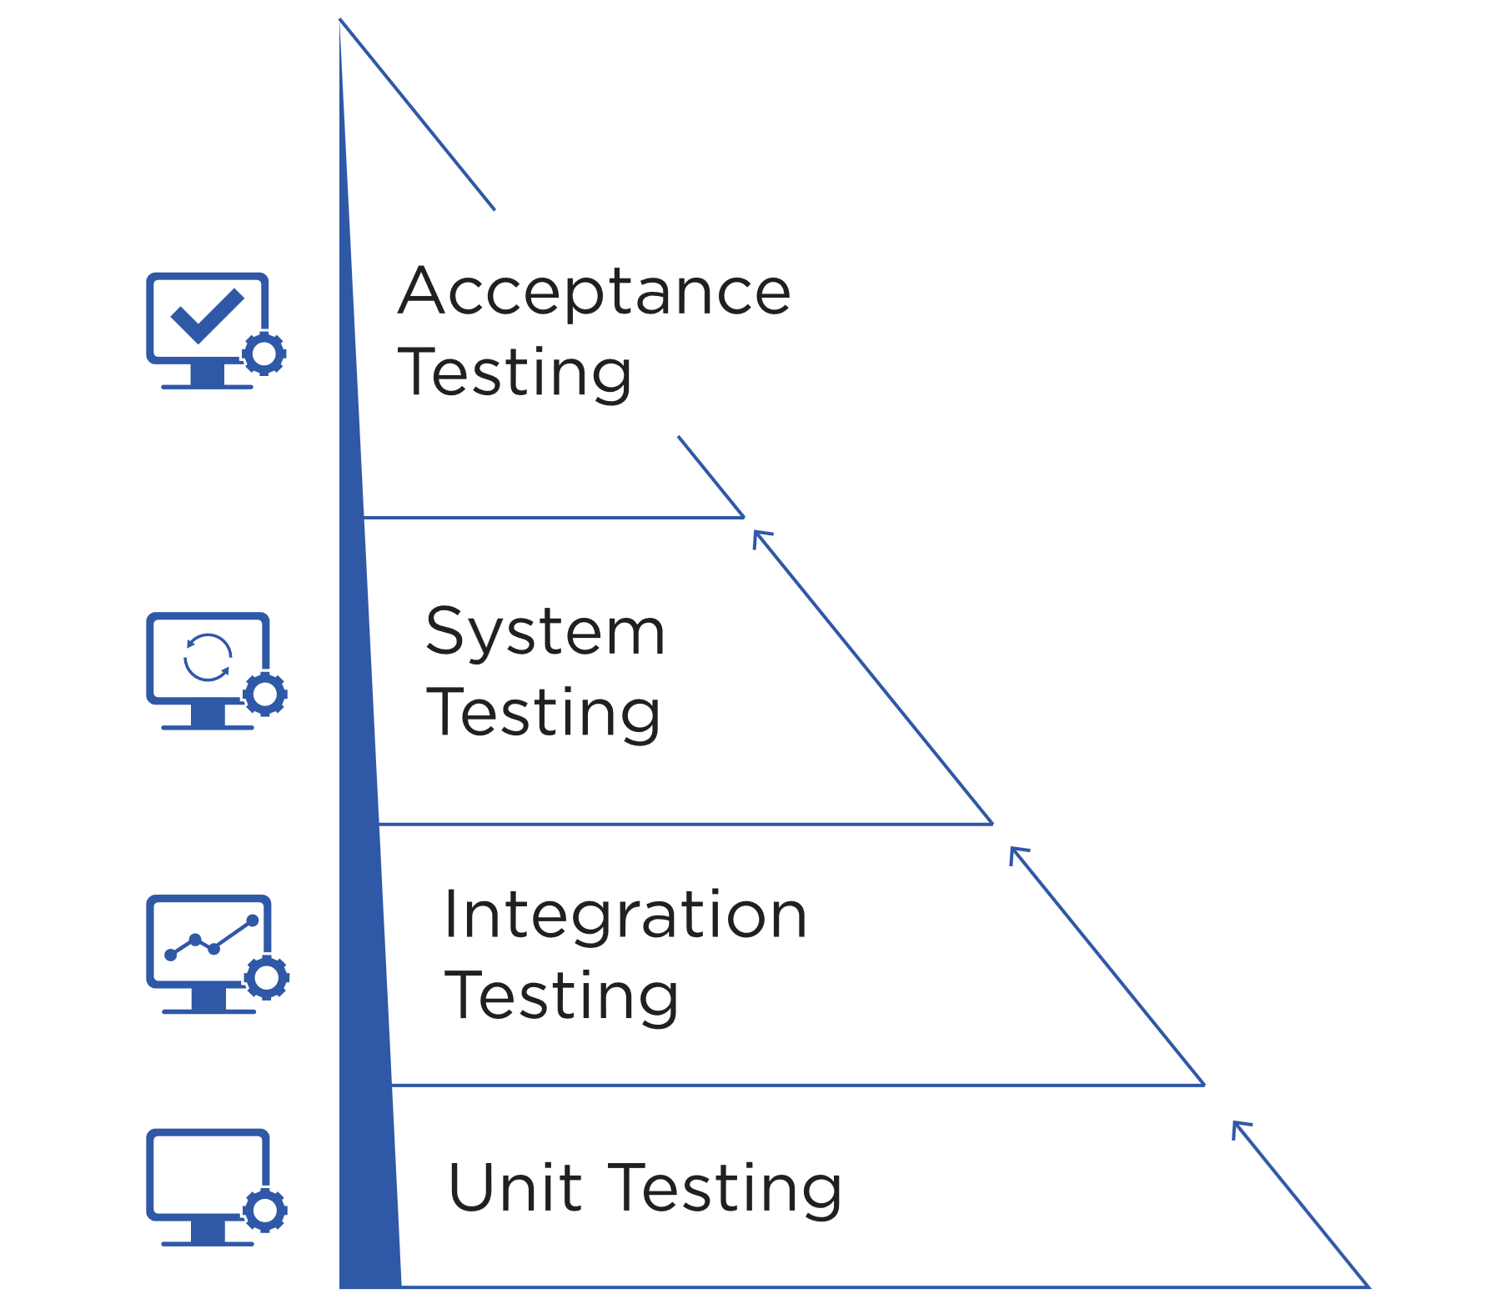
Unit Testing
Manual Tests
Usually written by developers
Uses Assertions
Testing smallest part of the system in isolation
Best Performance – execute early, often and within few seconds
Smallest scope - easier to locate and understand errors
Frequency – Every code check-in or pull request
Use of test doubles to replace dependencies – dummies, stubs, spikes, mocks
Increases confidence in changing/maintaining code
Notes:
How do we integrate security here?

Slide 41
Middle Layer Testing
Manual Tests
Together called service/API layer tests, also termed as “middleware layer”.
Component Tests: Look at individual components. Validates the functionality is working as expected with other components.
Integration Tests: Targets modules/features that integrate directly with other dependencies outside the application. Can be used as gating/staging from preprod to prod, etc.
System Integration Tests: Large scale integration suite testing end-to-end workflows. Often coordinated across teams and unique to your application or system.
Notes:
How do we integrate security here?

Slide 42
Acceptance Testing
Manual Tests
Similar to integration tests in the sense that they test different parts of the application
End-to-end testing
Ensure high-level functionality works as expected or described and delivers business value
Maximum scope such as - logics, UI workflows, navigation, transitions, calculations, buttons, layouts etc.
Can be brittle or flaky and a lot of work to maintain
Test critical workflows
Notes:
How do we integrate security here?

Slide 43
Manual Testing
Manual Tests
Not regression testing
Experience + creativity
Learn about the system, discover defects & improve automated testing
Can be based on missions/test charter/persona
Covers scenarios which can’t be automated or are too complex to automate
Edge Scenarios for mission critical applications to prevent failure
Notes:
How do we integrate security here?

Slide 44



Thank you!
If you have additional questions, please reach out to me at:
asanders@gamuttechnologysvcs.com

